Slide 1
Job Request System JRS
JRS Support Team

Slide 2
Agenda
Introduction
Contact Information (Support Hours and Processes)
JRS Setup
Request JRS ID
JRS Access Level Definitions
Submit an Add, Change, Delete, Issue or Temp request
Locating a Request
Approving a Request
Status Flow Life Cycle
Other functions in JRS
Forgot your ID?
User preferences Section
Search Section
Security key symbol
Finding Group Owners
Disabled users and Denied users
Export to Excel
Filters Option
About Section

Slide 3
Introduction
The Job Request System also know as JRS version 1.0 is a standard Peraton tool for requesting batch scheduling changes.
Accomplish the ISO standards regulations
Production Support Team (Scheduling) uses JRS website to process requests for scheduling tools
Example of Supported Scheduling Tools:
CA AutoSys, and CA7 are the tools of choice, Control-M, ESP, IBM, Advance Job Scheduler, OneAutomation, Jobmaster, OPC, ROBOT Scheduler, Redwood, Tidal, TWS, Unicenter, NSM-JMO, UC4, Zeke, Zena, and Zebb.
Type of request: Permanent and temporary requests

Slide 4
Contact Information Support Hours and Processes
Batch Scheduling Processes, Service Level Objective (SLO)
Permanent Add/Change/Delete requests between 2 business days
Larger requests (25 or more) within 10 business days
Temporary requests within 2 hours
Hours of operation –
Monday thru Friday
JRS uses Greenwich Mean Time (GMT)
USA: 07:00 to 15:00 (Central)
Note: Specific Scheduling Groups have their own hours.
After hours support
Contact Batch Monitoring
Provide 24/7 support for problems

Slide 5
Contact Information Support Hours and Processes
On call/Email
Contact by email (business hours):
Contact scheduling support groups using their distribution list.
Contact by email (After hours):
Contact appropriate monitoring support team - they can contact on call scheduler.
On the JRS Home Page, there is a link for:
Scheduling and Monitoring Contact Information.

Slide 6
JRS Setup Steps needed to follow for Job Request System to setup a company
Define Company Name
Define Group(s) under company to support account requirements
Define Scheduling support (PSSR – Primary Support Sub Region)
Define Tool to groups
Define JRS IDs:
- Account determines who is responsible for individuals/access levels (Group Owner). - Group owner – is the first user defined on every company, it has the responsibility to confirm other individuals and assign access levels. - The account determines who submits requests with/without approval .
- All the individuals/users who request a JRS ID are confirmed by the group owner.

Slide 7
Request JRS ID Create a JRS ID
Open an internet browser (recommend Chrome or Firefox)
Go to https://jrs.dcs-usps.com
On right hand side, below Get Started, click on “Request a JRS ID”

Slide 8
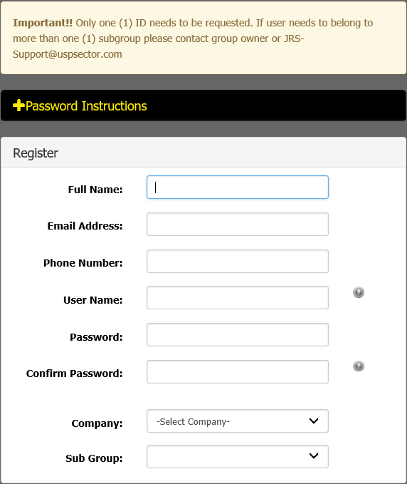
Request JRS ID Create a JRS ID
Do not use special characters like #$%&*()_+-'"@<> to type your Full Name or User Name
Make sure that the password complies with the minimum complexity requirements. (information provided under password instructions section)
Select the appropriate company. If company is not defined to JRS, send email to. jrs-support@uspsector.com
Select the group the user needs to be related to. If the user needs to be part of multiple subgroups, the respective group owners or JRS Support need to define the user on the other groups.
Note: Select the appropriate Company and Sub Group the user needs to be related to avoid delays on confirmations.

Slide 9
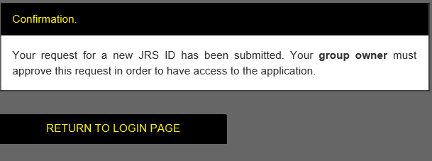
Request JRS ID Create a JRS ID
Below the form, click on “Create New User” to submit information.
An email will be sent to the group owner to confirm JRS ID
A confirmation page will be displayed to inform the request has been sucessfully received
Note:
If a group is selected that does not have a group owner, an email will been sent to the JRS Support to handle your request. Otherwise the group owner receives an email notification.
If unsure of the information to provide or selected, click on the “Cancel Action” button to go back to the login page.
Only one JRS ID is required, if user needs to belong to more than one company/group, the group owner or JRS Support can add JRS ID to other companies/groups.

Slide 10
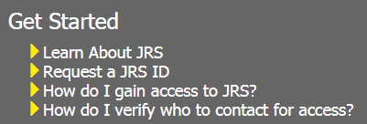
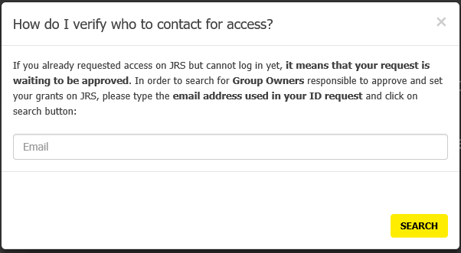
Request JRS ID Create a JRS ID
If JRS ID request was already submitted and unable to log onto JRS, it probably means the access for the JRS ID has not been approved yet.
As informed previously, the group owner must approve JRS ID request in order to allow access to the application.
On JRS login page, there is a link “How do I verify who to contact for access ?“ After clicking on this link, a box will be presented to type the email address used in JRS ID request. Click on search button to see a list of group owner contacts. If this list shows as blank please contact jrs-support@uspsector.com

Slide 11
JRS Access Level Definitions User responsibilities and permissions on the JRS
Scheduler: Scheduler access for company Enterprise Hosting. Accounts may or may not see this option.
Group Owner: Is the first user that should be defined to every group. Confirms JRS ID requests to company/subgroup. Maintains list of individuals and access levels updated for group. On the system there's a Group owner instructions link available under the View Users section.
Type of users: Only one of the below access levels should be selected.
View Only – Able to access JRS , but unable to submit requests.
Requestor – Able to submit requests that requires further approval.
Authorized Requestor - Able to submit requests without further approval.
Approver: Approves requests submitted by Requestors.

Slide 12
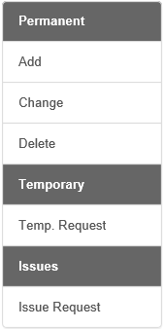
Creating a JRS Request Submit an Add, Change, Delete, Issue or Temp request
From the JRS Home Page, on the left hand side there will be a Menu:
Click on desired request type:
Permanent:
Add
Change
Deleted
Temporary:
Temporary request
Issues
Issue request

Slide 13
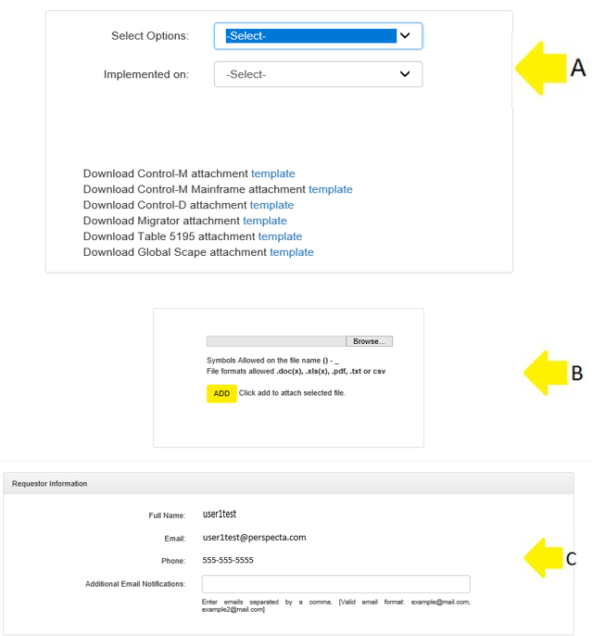
Creating a JRS Request Submit an Add, Change, Delete, Issue or Temp request
If any option under Permanent is selected, the system will require specific information
Select Options:
Select Company/Group/Tool combination.
Implemented on:
Select Non-production or Production.
Ability to attach files with the “Browse” button. Attached files can also be deleted.
If necessary the requestor has the ability to add additional email notifications separated by a semicolon.

Slide 14
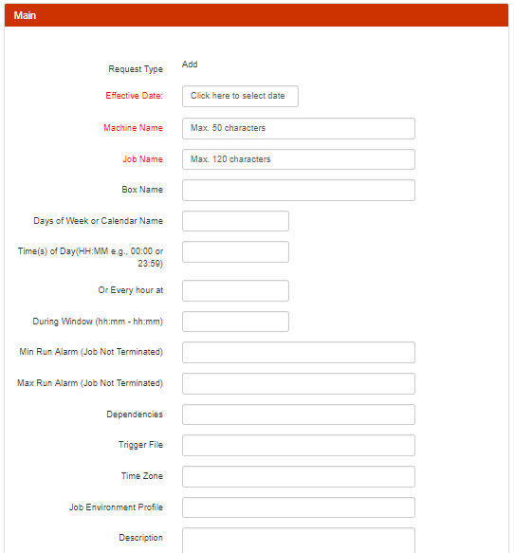
Creating a JRS Request Submit an Add, Change, Delete, Issue or Temp request
If Permanent is selected, the system will require specific information I.E.: AutoSys Environment.
After selecting the company/group/tool, the system/tool input form will be displayed.
Fill in appropriate fields in the form to communicate requested details.
Click on “Submit New Request” at bottom of page.

Slide 15
Creating a JRS Request Submit an Add, Change, Delete, Issue or Temp request
Once request is submitted, a message will be displayed to let the requestor know:
Request Identification number (Req.ID)
Initial Status: Awaiting Approval or Open.
It will show the PSSR (Primary Support Sub Region) PSSR is the scheduling group responsible for processing the request.
Note: In the screenshot, the request status is in Awaiting Approval because of the access level of the user.

Slide 16
Locating a Request On the system there are two different ways to find a JRS request
Accessing the appropriate request queue (Permanent / Temporary / Awaiting Approval) and look for request identification number (Req. ID).
Using the “Search” section on the main menu.
To open a request
Click on the system image located at the beginning of the request ID

Slide 17
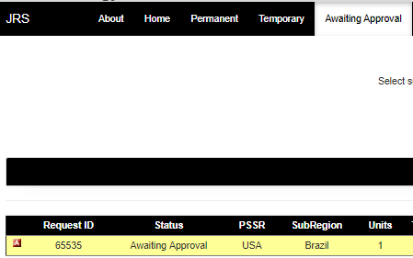
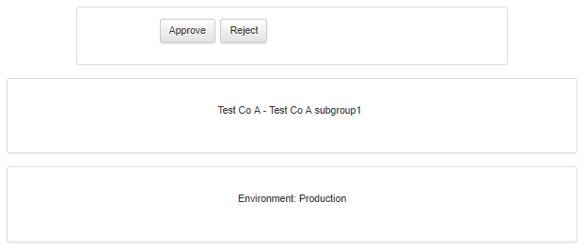
Approving a Request
If a request is raised by a Requestor, the request will need further approval by an Approver.
An approver can approve or reject a request if it is in Awaiting Approval status. Once it has been handle by an Approver an email will be sent to the requestor to notify that the request status has changed.
All the requests that require further approval could be located in the Awaiting Approval section on the main menu.
An approver needs to access the Awaiting Approval section to Approve or Reject the request.

Slide 18
Approving a Request Finding Approvers
If an approver for a request is needed (or want to know), go to the Approvers section on the main menu. Select Company and subgroup of request, the result will display a list of approvers

Slide 19
Status Flow Life Cycle
Awaiting Approval
(If submitted by requestor)
Open
Acknowledged
WIP
Work in Progress
Completed
Verify / Close
Status | Available Actions
Awaiting Approval | Approve/Reject
Open | Acknowledged/WIP/Reject
Acknowledged | WIP/Reject
WIP | Completed/Reject
Completed | Verify/Close/Open/Awaiting Approval
Verify/Close | Open/Awaiting Approval

Slide 20
Other functions in JRS Forgot JRS ID/Password?
If a user experiences issues with the JRS password, this could be recovered from the system on the page https://jrs.dcs-usps.com as long as email information is valid.
On right hand side, click on the “JRS ID/Password Recovery”
Note: The JRS user password never expires.

Slide 21
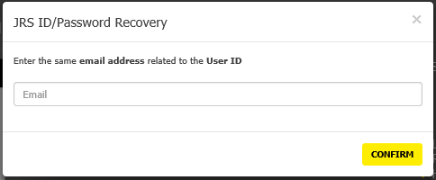
Other functions in JRS Forgot JRS ID/Password?
The system will display a box to enter email address related to JRS ID.
Click on Confirm.
JRS will send an email with details about JRS ID to the email defined to JRS ID.
If you do not receive an email, please contact system administration jrs-support@uspsector.com
Note: The JRS user password never expires

Slide 22
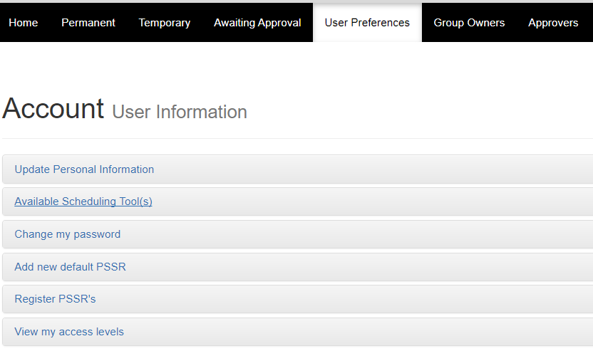
Other functions in JRS User Preferences Section
To update or view personal preferences within JRS, select the “User Preferences” option on the main menu. Click on topic to update/view.
Users may change the following fields:
Update Personal Information
Name, Email, Phone
Change my Password
Add New Default PSSR
Also able to view:
Scheduling tools assigned to JRS ID.
PSSR define to JRS ID.
Access Levels for JRS ID.
PSSR is the default views for requests in Permanent and Temporary queues. Automatically created from company definition. If adding additional company/subgroup to JRS ID, PSSR may need to be updated. It indicates the scheduling group responsible for requests created.

Slide 23
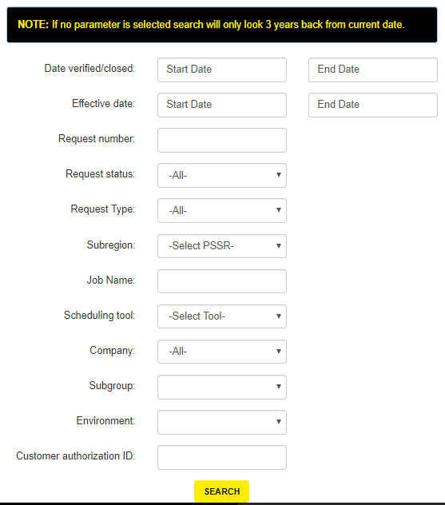
Other functions in JRS Search Section
On the main menu the user could find a Search section where a search can be performed by multiple fields.
Date verified closed (start and end dates)
Effective Date (start and end dates)
Request Number (Req.ID)
Request Status
Request Type
Scheduling tool
Company JRS ID is defined to
Subgroup JRS ID is defined to
Customer authorization ID
Etc.
Note: If no parameter is selected search will only look 3 years back from current date.

Slide 24
Other functions in JRS Search Section
Select the “key” image under the welcome message to see what subgroups and access levels are assigned to the JRS ID. Click on the security key again to get rid of the display.

Slide 25
Other functions in JRS Finding Group Owners
If a group owner for a company/group is needed (or want to know), select Group Owners from the main menu. Select Company/group of request, the result will display a list of Group Owners

Slide 26
Other functions in JRS Disabled Users and Denied Users
All Group Owners have access to user history for Disabled users and Denied users on Group Owners page.
Below the Group Owners List are two drop downs with the user history information.

Slide 27
Other functions in JRS Export to Excel
When viewing requests in the Permanent, Temporary, Awaiting Approval queues, or after a search is performed, the user can export information to an excel spreadsheet.
Group Owners can export list of individuals to Excel spreadsheet when in the View Users Screen.

Slide 28
Other functions in JRS Filter Option for Request Pages
On request pages, below Export to Excel button, you can find a black stripe called Filters.
The best options can be chosen in order to help with the Request List visualization.
Applying the filter WILL NOT change the content for Export File. To apply the filter click on Apply button.

Slide 29
Other functions in JRS About Section
There's a section on the main menu named “About”. In this section the user could find all the information regarding the current JRS version and the change historical of the previous JRS versions.

Slide 30
Questions?
If you have any questions regarding JRS please send an email to:
jrs-support@uspsector.com
Thank you

